Slide 1
Building Web Applications using Java
Dominic TIppabattuni

Slide 2
Contents
Basic Web Application Components
Client / Server
URL
HTTP Protocol
Java Application Server
Three-Tier Web Architecture

Slide 3
Contents
Web Application Development Process
Java Application Frameworks
MVC Design Pattern
Spring Boot Overview
Demo Spring-Boot Web Application without database
Demo 3-Tier Spring-Boot Web Application
References

Slide 4
Basic Web Application Components
Web Client
Web Server
HTTP Request
HTTP Response

Slide 5
URL – Uniform Resource Locator
AKA - Web Address
Used to identify web resource on a computer network
URL structure:
scheme:[//[user[:password]@]host[:port]][/path][?query][#fragment]
Sample schemes HTTP, HTTPS, JDBC, FTP etc
Example: https://www.google.com/search?q=url

Slide 6
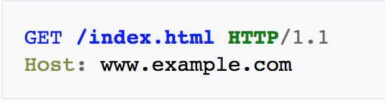
HTTP – Hypertext Transfer Protocol
Communication protocol used by client – server
Uses Request – Response model
Sample HTTP Request
HTTP Methods: GET, POST, DELETE

Slide 7
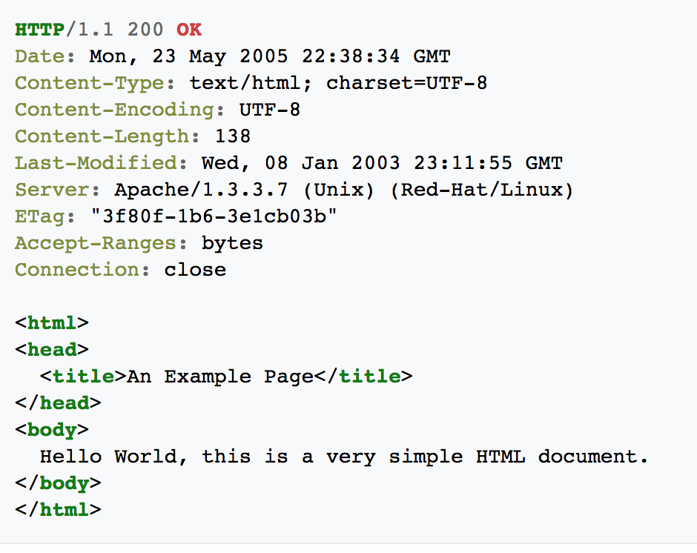
HTTP – Hypertext Transfer Protocol
Sample HTTP Response

Slide 8
Java Application Server
Provides ability to run Java code based on web requests
Java Platform, Enterprise Edition or Java EE specification
Web Specification ( Servlets, Web Sockets, Java Server Faces )
Enterprise Java Bean Specification - EJB ( Concurrency control, dependency injection, access control )
Tomcat, IBM Websphere, Oracle Weblogic, Glassfish, Jetty

Slide 9
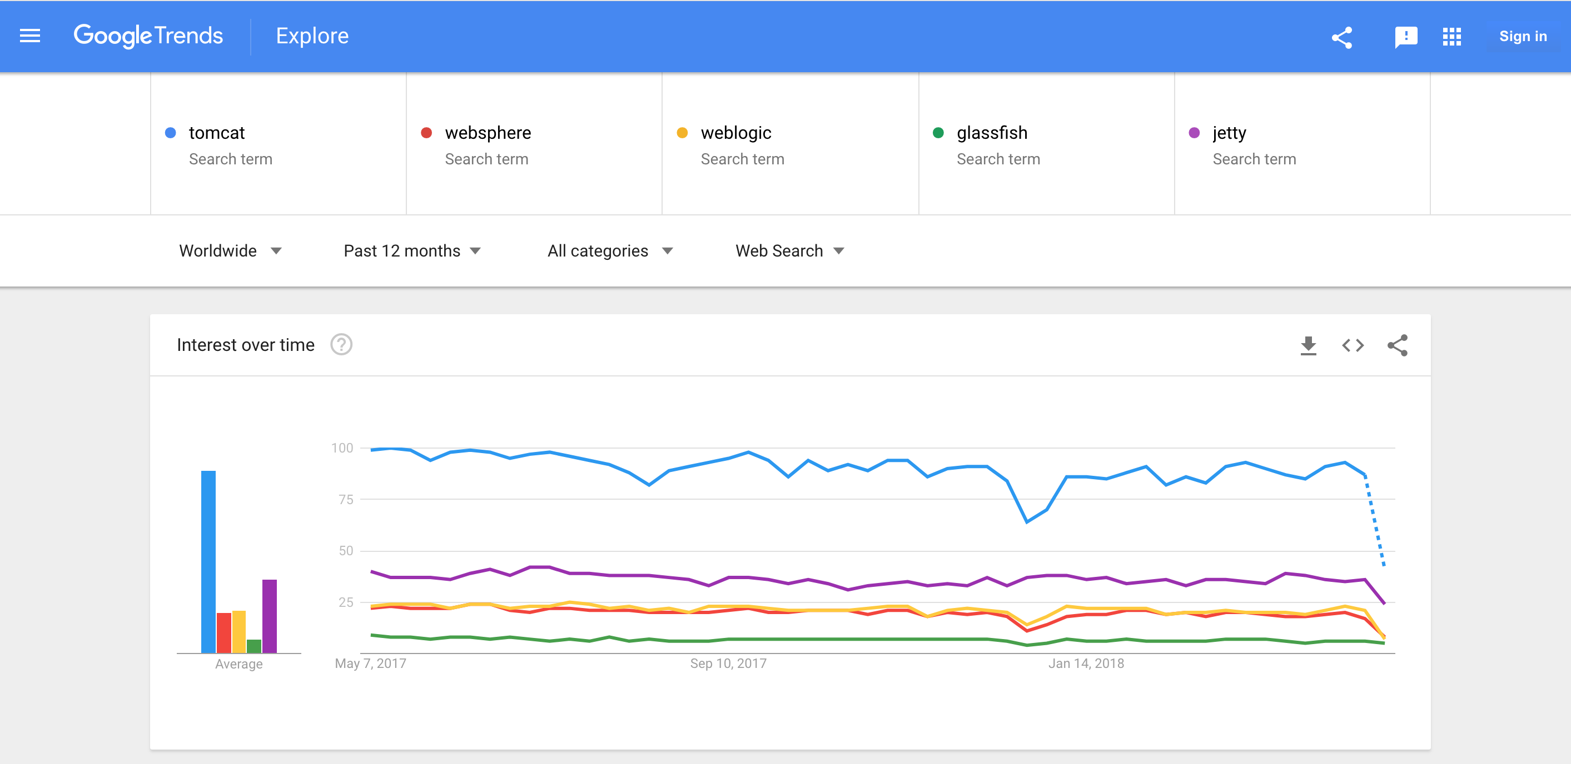
Java Application Servers

Slide 10
Java Web Application Folder Structure

Slide 11
Java Web App Development Process
Develop
Describe
Compile
Package
Deploy
Access

Slide 12
Lab 1
Goal: Set up and run sample web application
https://gist.github.com/dtippabattuni/df48368e37305e29307f3ae099e0de1c

Slide 13
Java Web Application Request Handling

Slide 14
Three–Tier Architecture

Slide 15
Java Web Application Frameworks
Provide standard way to build and deploy web applications
Reduce overhead associated with common activities
Include additional APIs / Libraries
Session Management
Database Access
Templating
Spring MVC, Spring Boot, JSF, Play, Struts, Vaadin, GWT, JHipster

Slide 16
Model-View-Controller Design Pattern
Reusable solution to organize code for efficient code reuse and parallel development
Model
Central Component
Contains application behavior ( data, logic and rules )
View
Presentation of the model ( HTML, XML, JSON etc )
Controller
Handles user inputs, input validation and interacts with model

Slide 17
Model-View-Controller Design Pattern

Slide 18
Spring Boot Overview
Takes an opinionated view of building production ready applications.
Easy to start a new Spring-Boot project
Minimal upfront configuration
Uses Spring MVC framework
Works with various IDEs including NetBeans
Provides annotation based configuration
Contains embedded Java Application servers ( Tomcat, Jetty etc )

Slide 19
Spring Boot Application Development Process
Develop
Run
Access

Slide 20
Demo 2 – Basic Spring Boot Application
Download:
https://github.com/dtippabattuni/gs-serving-web-content/archive/demo1.zip
@SpringBootApplication :
Other Annotations: @Controller, @GetMapping, @RequestParam
HTML view
Thymeleaf Template Engine
Embedded Tomcat Server

Slide 21
Demo 3 – Three-Tier Application
Download Url:
https://github.com/dtippabattuni/gs-serving-web-content/archive/demo2.zip
Connects to jdbc:derby://localhost:1527/sample;create=true
@Repository annotation
"a mechanism for encapsulating storage, retrieval, and search behavior which emulates a collection of objects”
Uses Spring JdbcTemplate API

Slide 22
References
https://en.wikipedia.org/wiki/Hypertext_Transfer_Protocol
https://en.wikipedia.org/wiki/URL
https://docs.oracle.com/javaee/6/tutorial/doc/gfirp.html
https://www.flaticon.com/packs/web-design-2
https://start.spring.io/
https://docs.spring.io/spring-boot/docs/2.1.0.BUILD-SNAPSHOT/reference/htmlsingle/

